Slide 1

Steven Phan, Megh Shah, Ishaan Patel
Notes:
Everyone introduces themselves

Slide 2
Baseline CPU + Performance
5 Stage Pipelined CPU
Hazard Detection Unit
Forwarding
Assume Fmax is 100 Mhz
Competition | comp1.s | comp2_i.s | comp3.s
Execution Time (ns) | 2.189 million | 6.214 million | 4.152 million
Notes:
Megh

Slide 3
Advanced Features
Cache
L2
Parameterized Sets
4 Way Set Associative
Prefetching (Basic)
Eviction Buffer
RISC-V M. Extension (Basic)
Notes:
All (person who does a certain feature speaks)

Slide 4
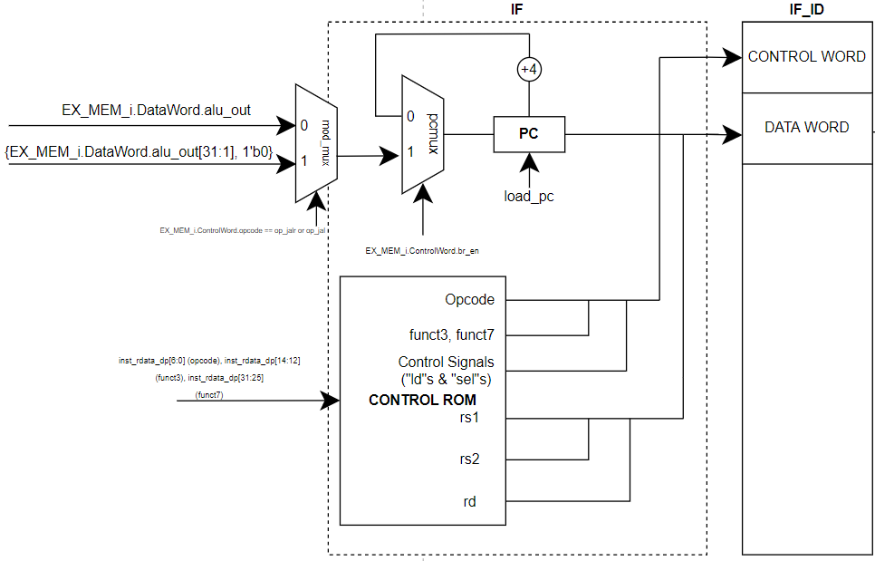
Datapath: Instruction Fetch
Notes:
Ishaan

Slide 5
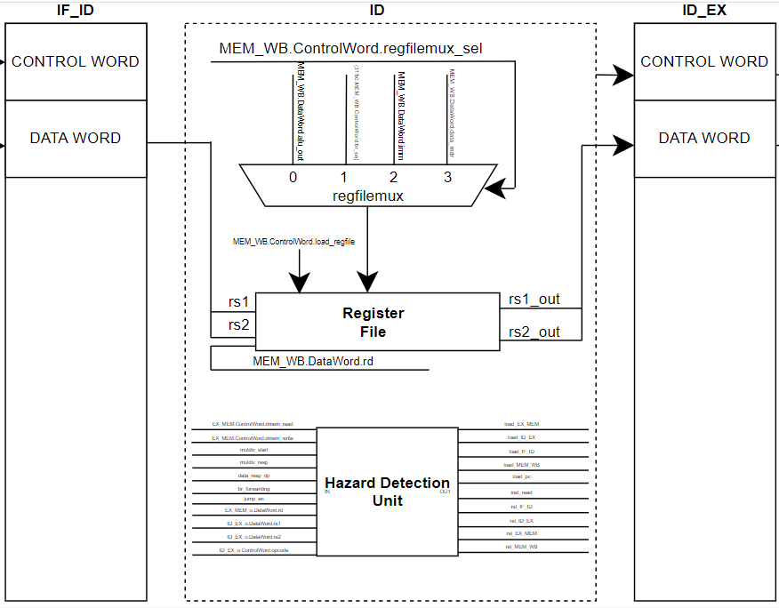
Datapath: Instruction Decode (+Writeback)
Notes:
Ishaan

Slide 6
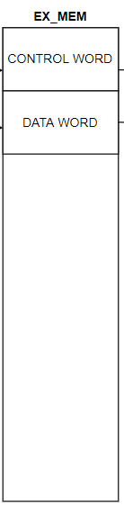
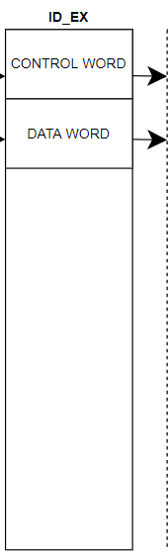
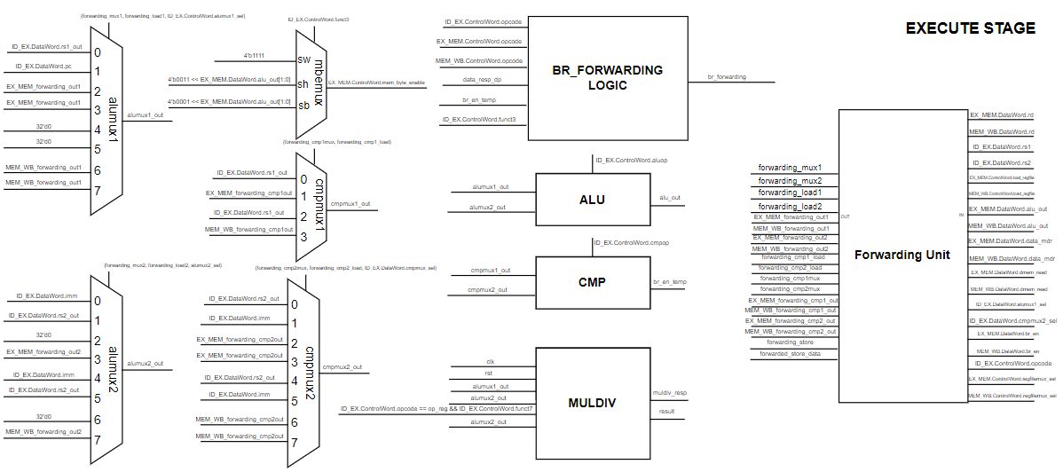
Datapath: Execute
Notes:
Megh

Slide 7
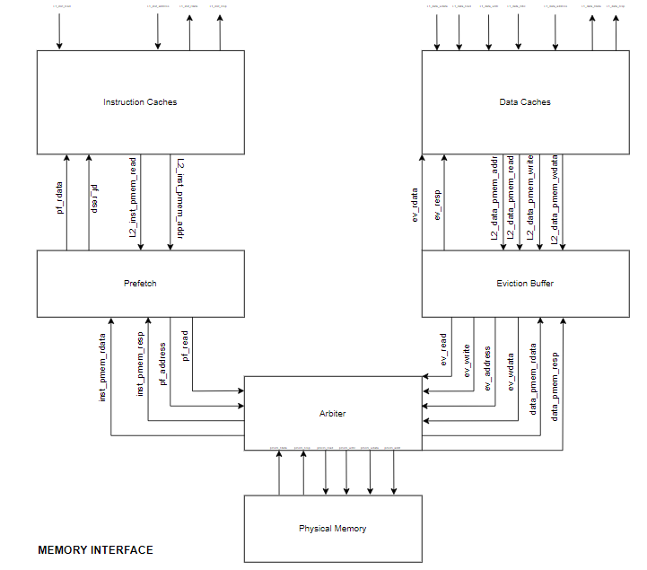
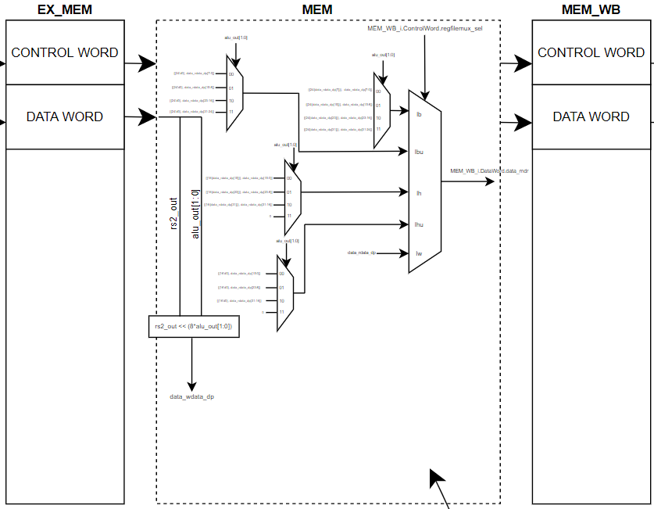
Datapath: Memory
Notes:
Steven (Prefetch + Eviction) + Ishaan (Cache Hierarchy, instr and data)

Slide 8
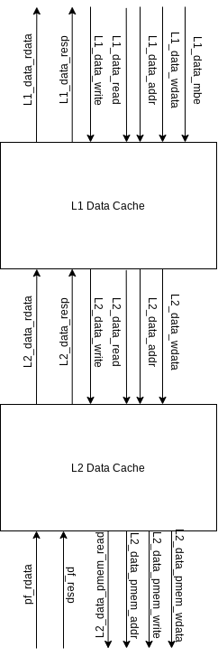
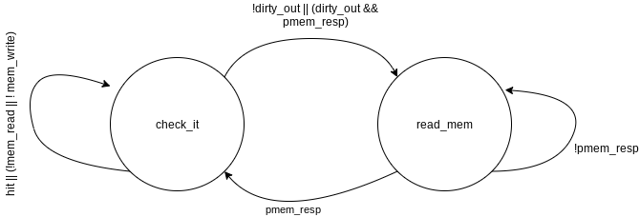
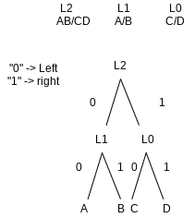
Cache Design
Way to Evict | LRU State
D | 0X0
C | 0X1
B | 10X
A | 11X
Notes:
Ishaan

Slide 9
Cache Performance
Better
Assuming Fmax is 100 Mhz
Counter/Competition | comp1.s | comp2_i.s | comp3.s
Counter (# used) | L1 Inst: Hit: 57796 Miss: 25 L2 Inst: Hit: 57821 Miss: 25 L1 Data: Hit: 3845 Miss: 7 L2 Data: Hit: 3852 Miss: 7 | L1 Inst: Hit: 135284 Miss: 76 L2 Inst: Hit: 135360 Miss: 76 L1 Data: Hit: 7090 Miss: 24 L2 Data: Hit: 17129 Miss: 24 | L1 Inst: Hit: 66018 Miss: 33 L2 Inst: Hit: 66051 Miss: 33 L1 Data: Hit: 13410 Miss: 283 L2 Data: Hit: 13693 Miss: 283
Execution Time (ns) | 588,495 ns | 1,390,715 ns | 675,185 ns
Notes:
Ishaan

Slide 10
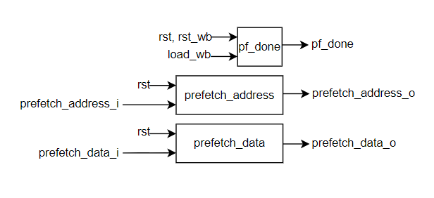
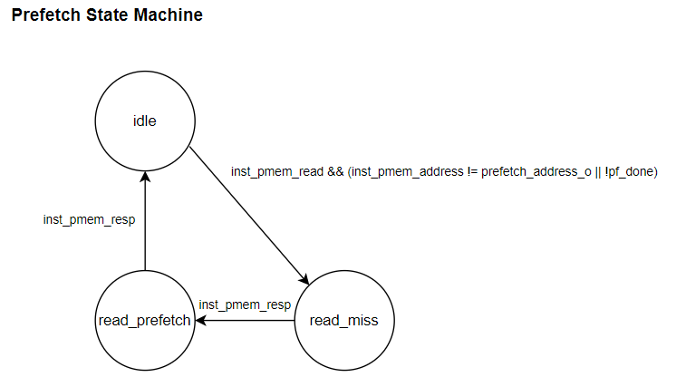
Prefetching Design
LLC requests a read
Buffer the next cache-line
Read next cache-line when free
Only return prefetched data when the data in the buffer is valid (pf_done)
Notes:
Steven

Slide 11
Prefetching Performance
Assuming Fmax is 100 Mhz
Counter incremented every time in idle and prefetched data is valid (address match and pf_done is set)
Counter/Competition | comp1.s | comp2_i.s | comp3.s
Counter (# used) | 4,105 | 10,817 | 8,003
Execution Time (ns) | 3.597 million | 9.775 million | 8.101 million
Worse
Notes:
Steven

Slide 12
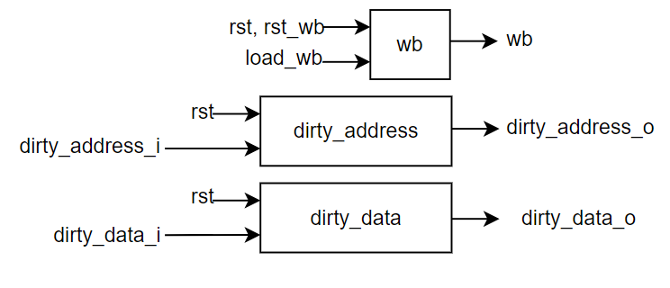
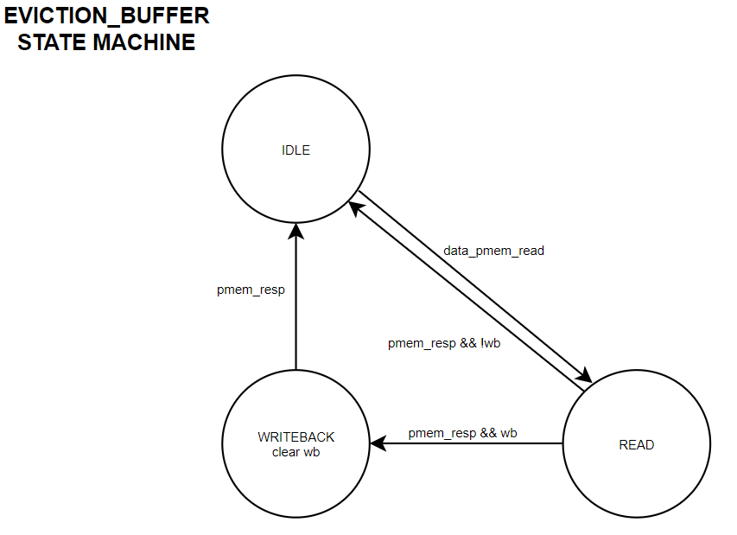
Eviction Buffer Design
LLC requests a read, but evicts data first because of miss
Buffer evicted data, evicted address, set a flag
Read missed address
Write back evicted data after read miss right away if flag set
Notes:
Steven

Slide 13
Eviction Buffer Performance
Assuming Fmax is 100 Mhz
Counter incremented every time in idle state and data_pmem_write is asserted
Counter/Competition | comp1.s | comp2_i.s | comp3.s
Counter (# used) | 7 | 260 | 728
Execution Time (ns) | 2.189 million | 6.205 million | 4.151 million
Better
Notes:
Steven

Slide 14
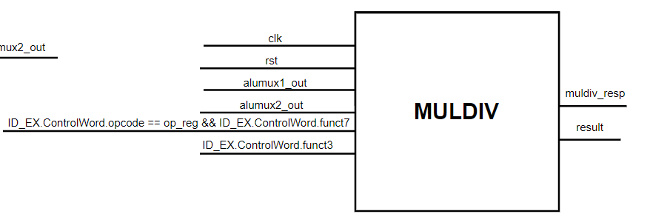
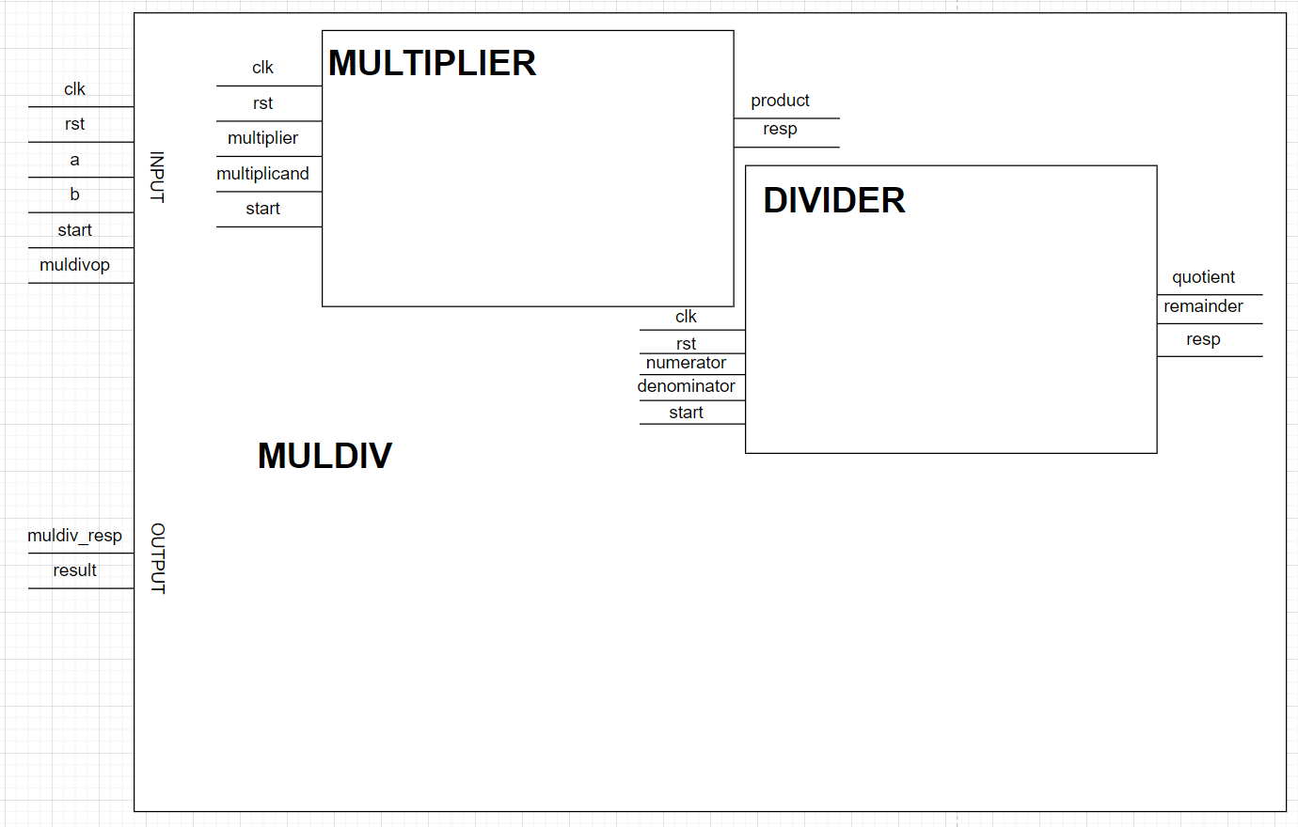
RISC-V M Extension Design
3-stage
repeated-add
3-stage
repeated-sub
High-level entity that simply passes data into correct module after decoding M Extension instruction
Notes:
Megh

Slide 15
RISC-V M Extension Performance
Assuming Fmax is 100 Mhz
Counter incremented every time an M Extension instruction is executed
Counter/Competition | comp2_i.s | comp2_m.s
Counter (# used) | 0 | 1,733
Execution Time (ns) | 6.214 million | 700,565
Better
Notes:
Megh

Slide 16
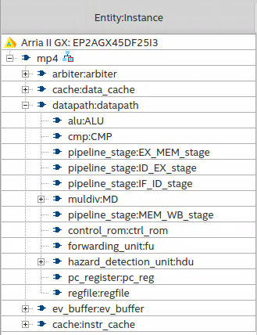
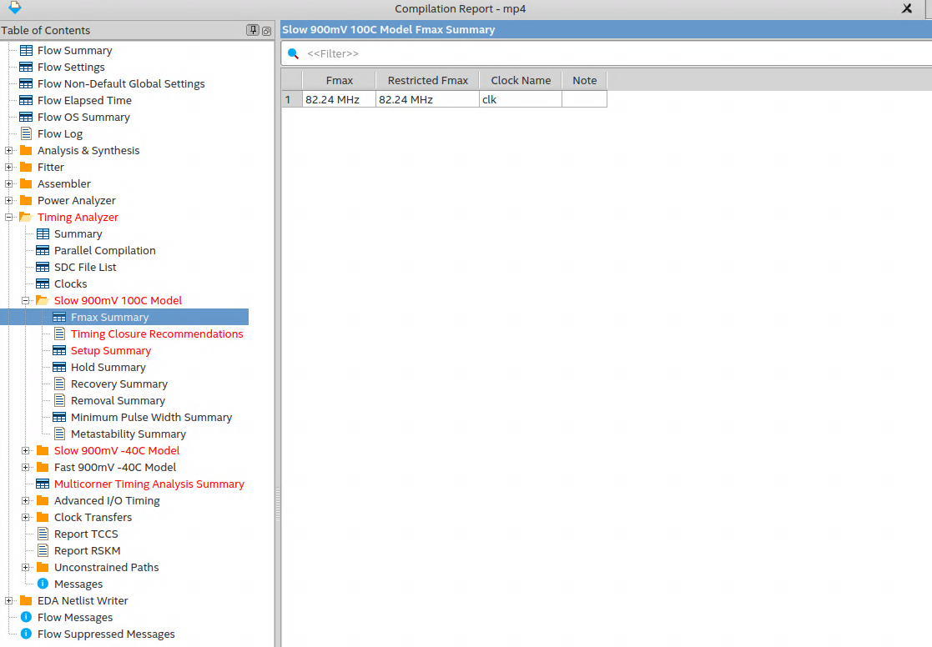

Final Design Choices
Changes
Removed L2 cache for both instruction and datapath
Removed prefetching block
Operating Fmax
82.24 Mhz
Notes:
Steven/Ishaan
Steven: explain why we removed prefetching (runtime got worse individually + not worth if we don’t have an accurate branch predictor)
Ishaan: explain why we removed L2 cache for both data/instruction (help with timing)

Slide 17
Final Design Performance
Combined Geometric Mean: 2.3856E-10
Final Design | comp1.s | comp2_m.s | comp3.s
Fmax (MHz) | 82.24 | 82.24 | 82.24
Power (mW) | 594.22 | 595.14 | 596.81
Runtime (ns) | 587,935 | 564,455 | 671,705
Scaled Runtime (ns) | 714,901 | 686,350 | 816,761
Score | 2.17E-10 | 1.924E-08 | 3.252E-10
Notes:
Megh

Slide 18
Any Questions?
Notes:
All

